Slide 1
GSM BASED SMART BIN
GROUP -10
Pavan Kumar. G - S20190020213
Shri Teja Naik. K - S20190020223
Sai venkat vijay.N - S20190020233

Slide 2
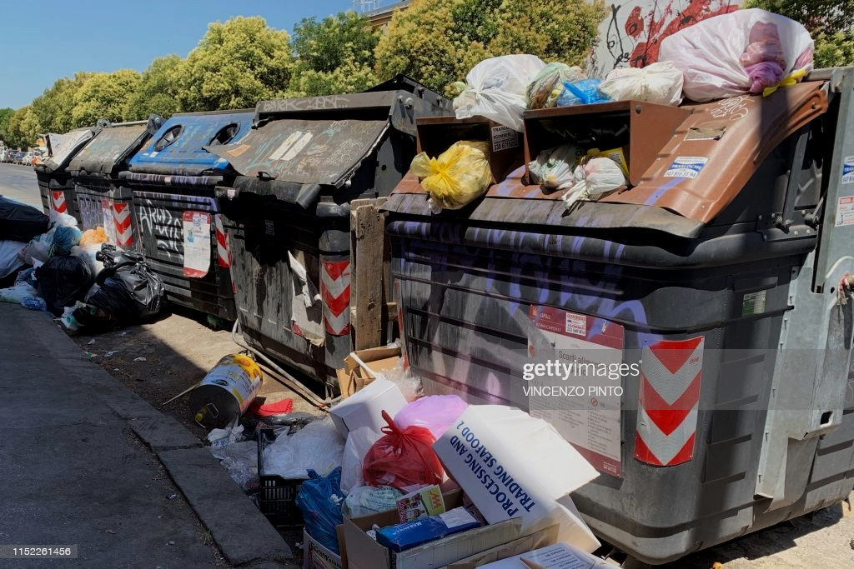
We often see the garbage bins in public places to over flow over days without cleaning or collecting them ,this causes many problems to both environment and to people’s health.

Slide 3
So to overcome this situation SMART BIN is helpful in emptying the bin in regular intervals.
How does SMART BIN WORKS?
By calculating the percentage of the bin filled in regular intervals with ultrasonic sensors and if the value crosses the threshold value it sends the coordinates to the server and the garbage collection vehicle using GSM to empty the respective bin.

Slide 4
Mid Evaluation Deliverables:
End Evaluation Deliverables:
Integrating GSM, GPS , Sonar sensors with Arduino and calculating the distance and uploading the coordinates to the Thingspeak server if it crosses the threshold level.
After uploading to thingspeak open those coordinates in app,and also sending notification to the garbage collection bin.

Slide 5
BLOCK DIAGRAM
ARDUINO UNO
GPS Module
Cloud
UltraSonic Sensor
GSM Modem
UltraSonic Sensor

Slide 6
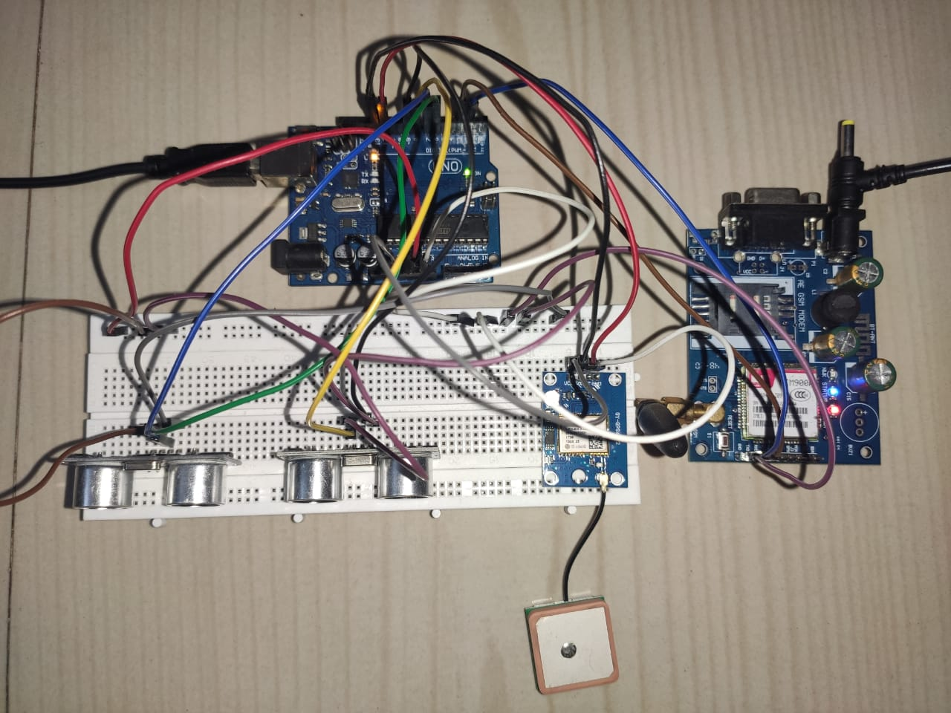
Arduino-Uno
Hardware:
Gsm Modem
UltraSonic Sensors
GPS Sensor

Slide 7
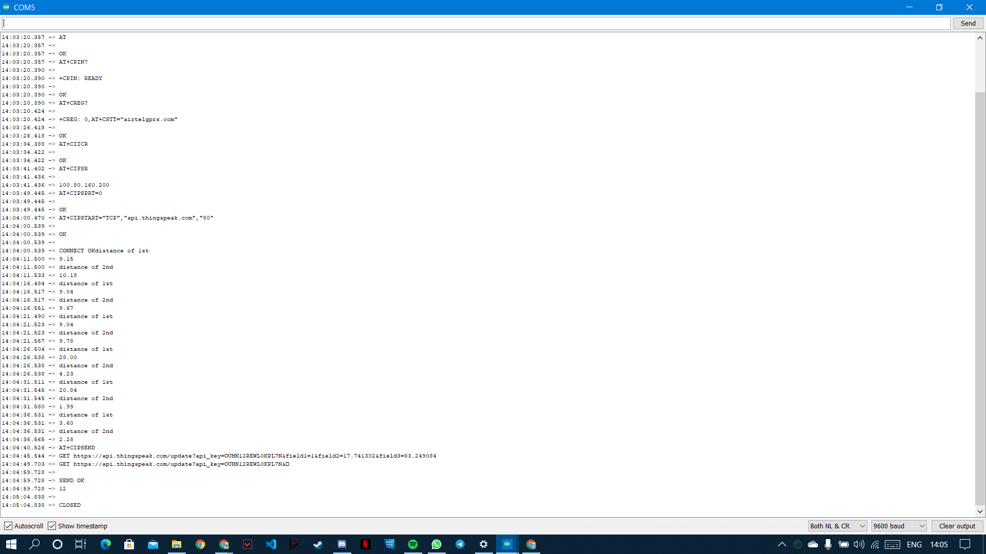
Serial Monitor Output screenshots:

Slide 8
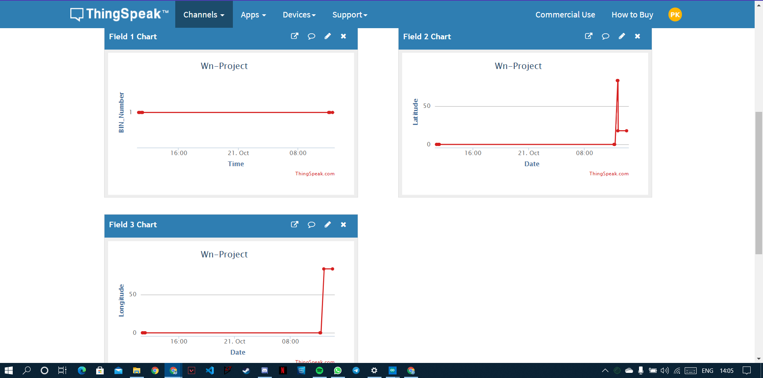
Thingspeak cloud Screenshot:

Slide 9
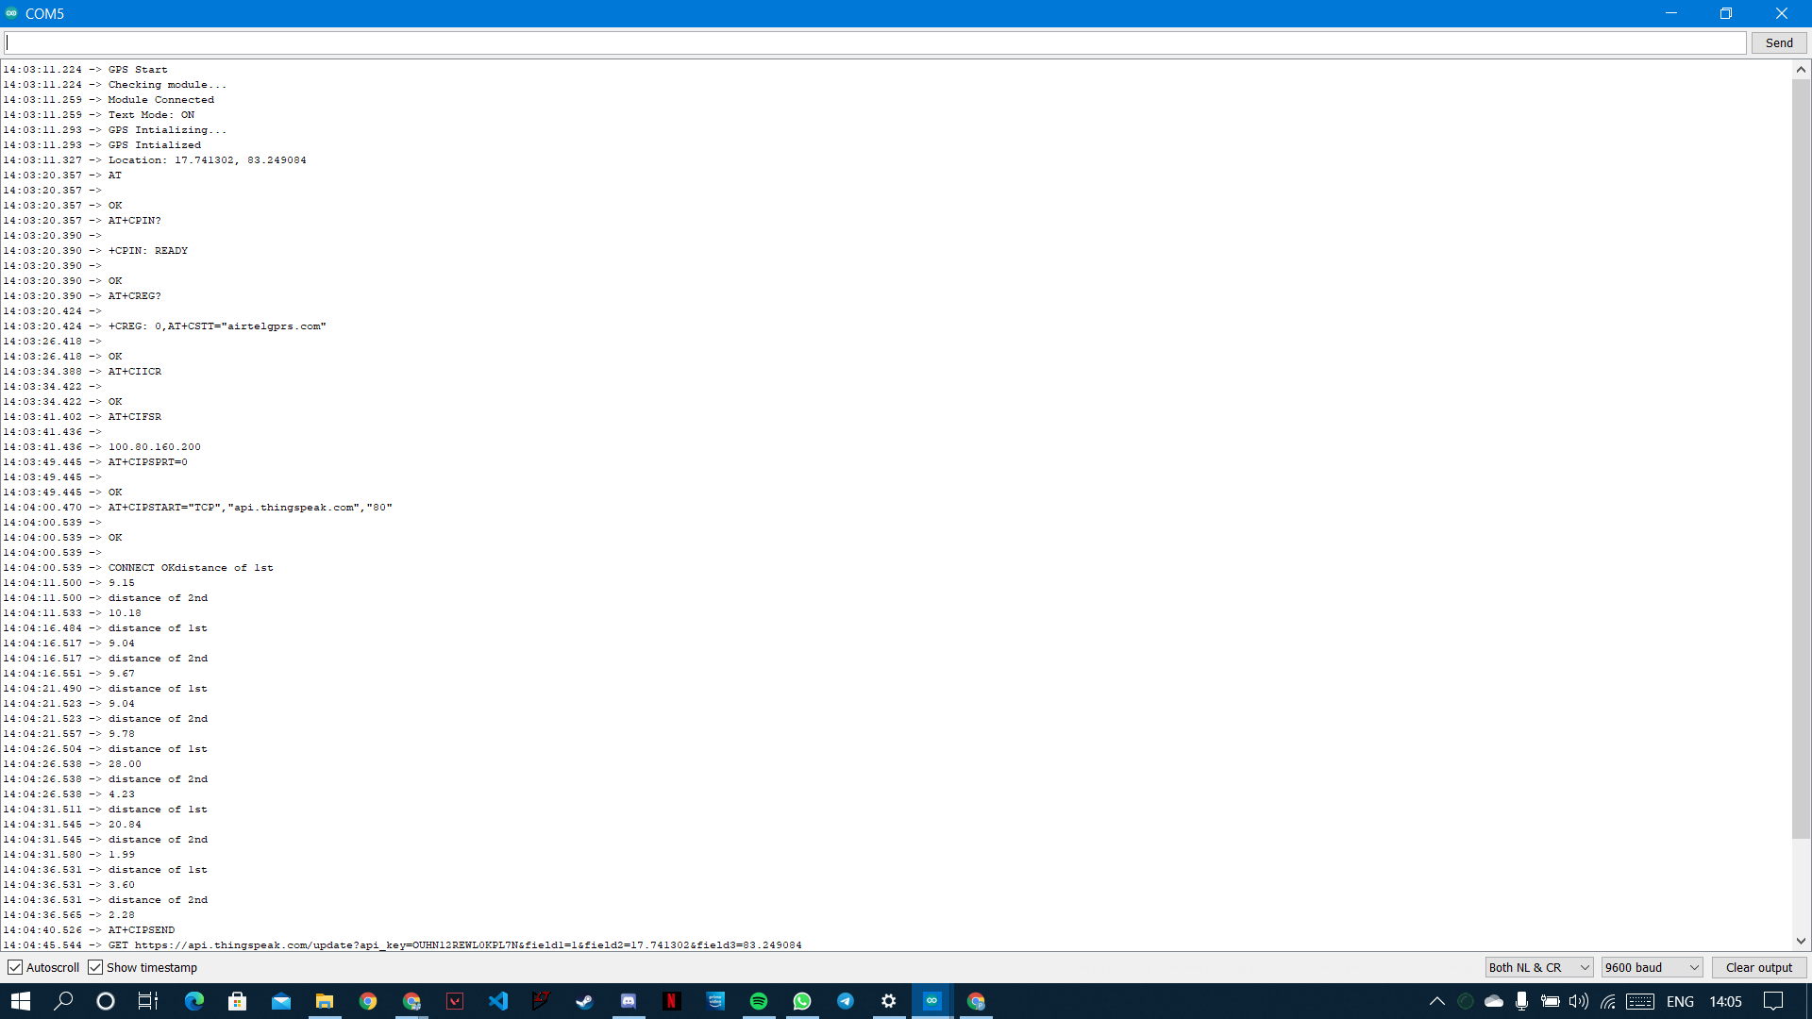

Slide 10
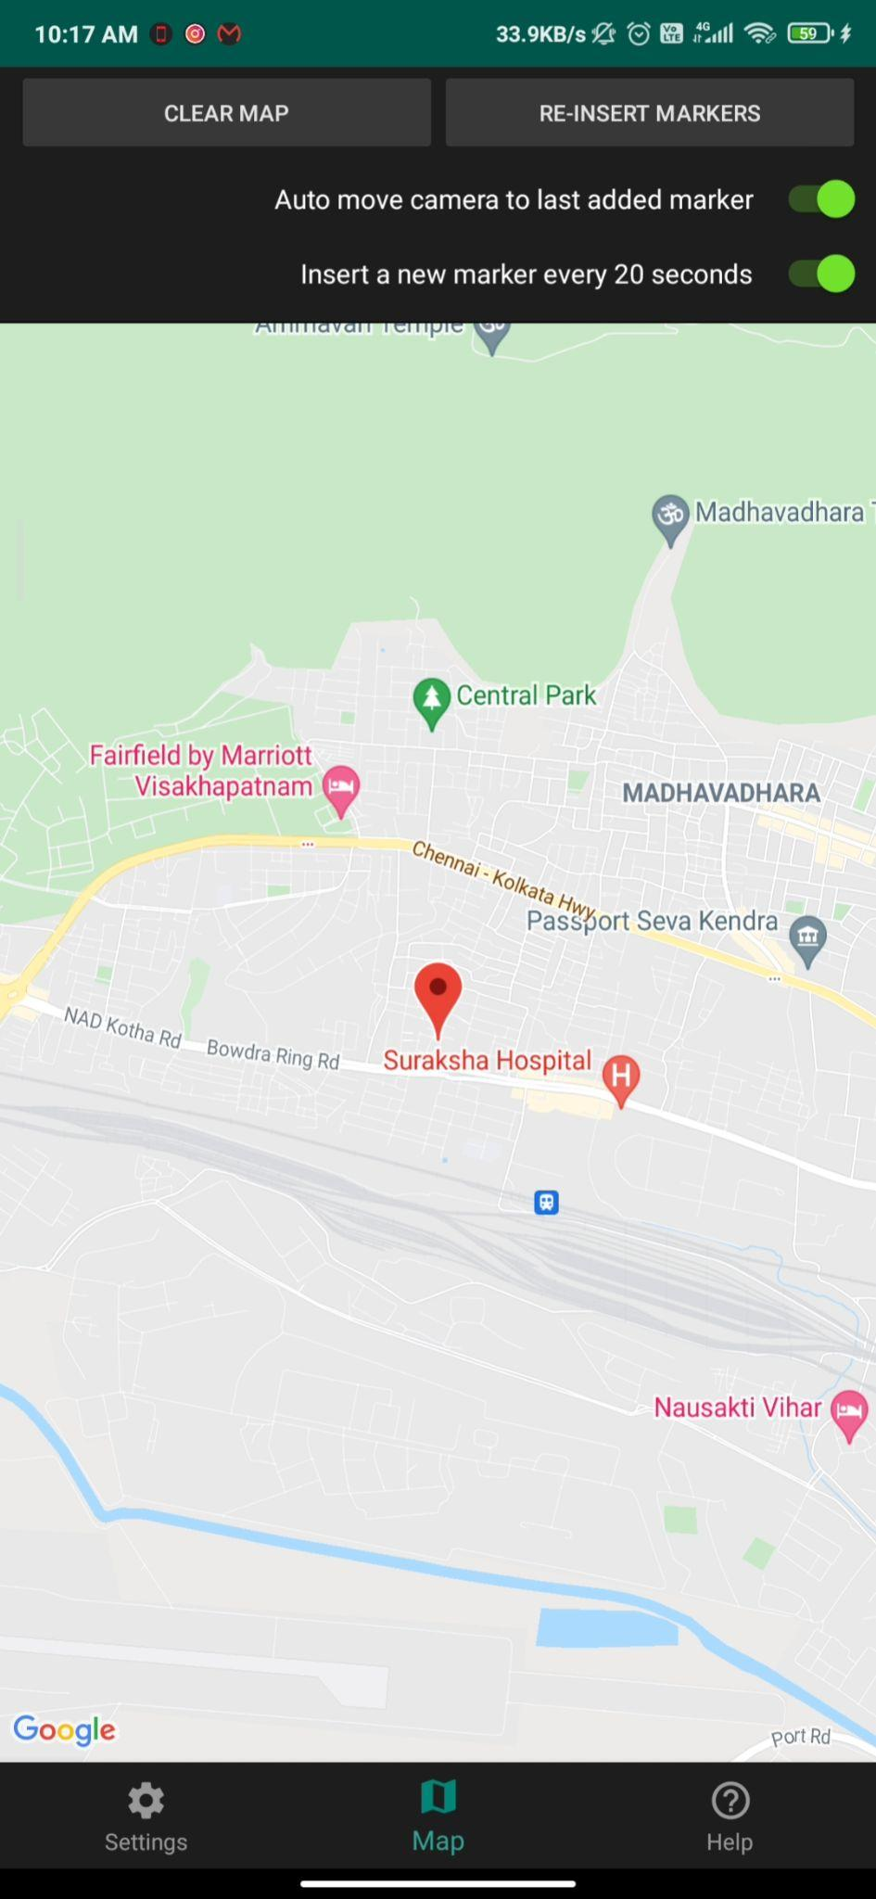
Screenshot of the location in the app

Slide 11
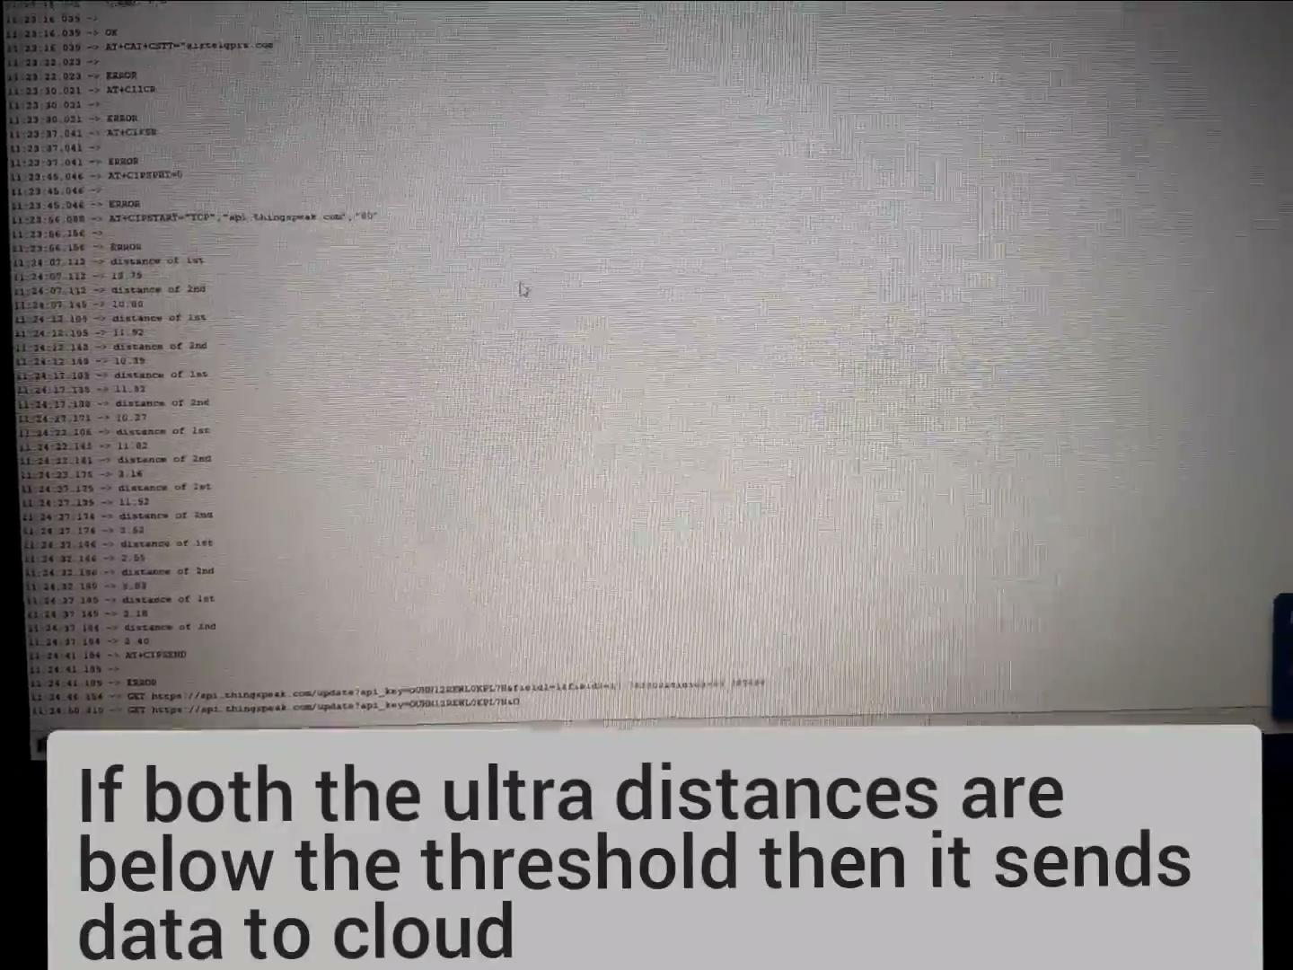
DEMO VIDEO :

Slide 12
Contributions:
Pavan Kumar.G - Hardware & Arduino Coding
Sai Venkat Vijay.N - App showing Location
Shri Teja Naik.K - Arduino Coding & Cloud

Slide 13
--------------------Thankyou --------------------------

